Slide 1

Q3 Board Update
Revenue steady, hosting cost per folder down again, renewal cliff unchanged.
Hollow Peak

Slide 2
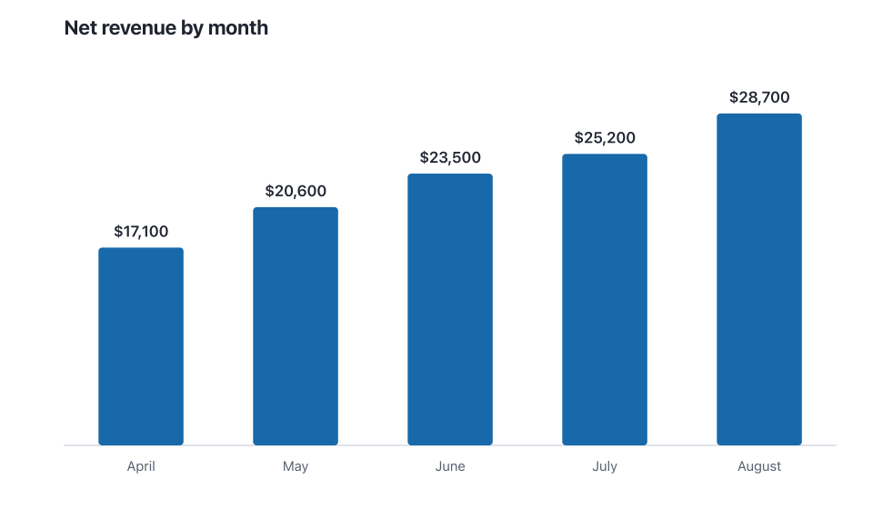
Net revenue by month
Hollow Peak

Slide 3
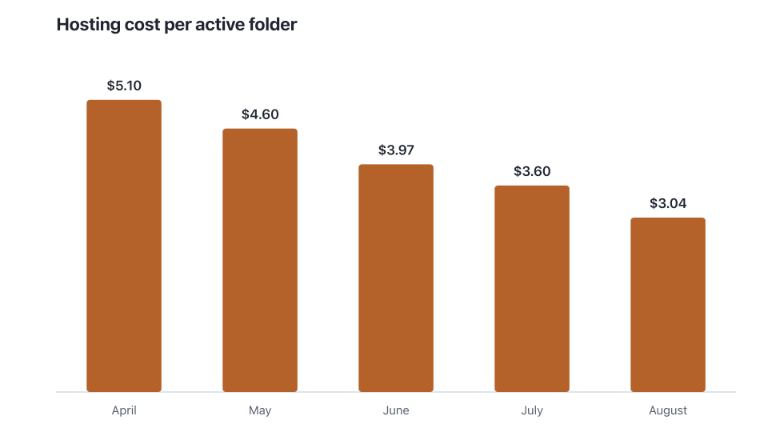
Hosting cost per active folder
Hollow Peak

Slide 4
What's next
Close out the August invoice before finalizing the figure
Decide whether the January renewal cliff belongs in the front matter or the appendix
Confirm chart colours print correctly for the physical board copies
Hollow Peak

